Slide 1
SC2001 • LAB 2
SC2001 Lab 2
Dijkstra’s Algorithm
Graph representation • Priority queues • Empirical complexity
JAY LI YIJIE (U2540332B)
JOEL LOH QUAN YU (U2421696K)
JUSTIN HOTASI (U2310560D)
Same shortest paths. Different amounts of work.
SC2001 | Project 2: Dijkstra’s algorithm
01
Notes:
Introduce the project: the algorithm remains Dijkstra, while the graph representation and priority queue change. This deck uses the same authors shown in the supplied Lab 1 deck. All measured results are operation counts, not elapsed-time speedups.

Slide 2
SC2001 • LAB 2
Two implementation choices affect the work
PART A
PART B
RESEARCH QUESTION
Matrix + array
List + min-heap
When is each better?
Scan possible neighbors.
Find the minimum by a linear queue scan.
Visit existing neighbors.
Extract minima and update priorities with a heap.
V = number of vertices
E = directed edges
R = successful updates
Θ(V²)
O((V + E) log V)
Compare counted work
Compare the same graph and source; change only the implementation.
SC2001 | Project 2: Dijkstra’s algorithm
02
Notes:
The project brief prescribes matrix plus array in part A and adjacency list plus minimizing heap in part B. Neither representation is required for Dijkstra correctness. The goal is to compare their costs, not to claim one always wins.

Slide 3
GRAPH REPRESENTATION
Build one graph; convert it two ways
Example: 0 → 1 (weight 4), 0 → 2 (weight 2), 1 → 2 (weight 1)
ADJACENCY MATRIX
LIST OF ADJACENCY LISTS
[None, 4, 2 ]
[None, None, 1 ]
[None, None, None]
[[(1, 4), (2, 2)],
[(2, 1)],
[]]
Scan V cells in row u.
Visit only u’s outgoing edges.
matrix[u] and adjacency[u] are both O(1) accesses.
SC2001 | Project 2: Dijkstra’s algorithm
03
Notes:
The edge list is the canonical input. Both conversions preserve the same directed weighted edges. None means absent, so zero remains a valid edge weight. Both outer containers are Python lists: indexing vertex u takes constant time. A list of lists does not require searching for u.

Slide 4
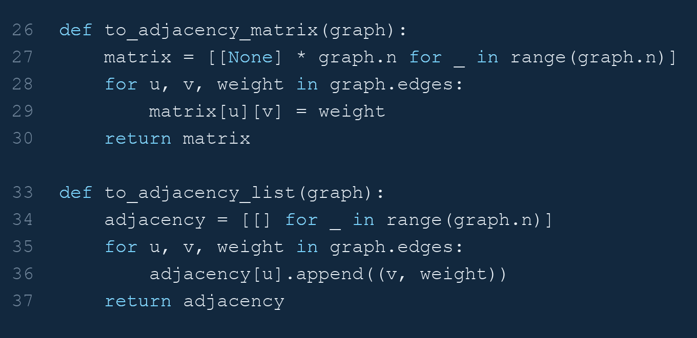
GRAPH REPRESENTATION
Actual code: graph conversions
Project_2_Dijkstra.ipynb • cell 4, lines 26–30; cell 4, lines 33–37
Matrix allocates V² cells; the list allocates V lists and appends E edges.
SC2001 | Project 2: Dijkstra’s algorithm
04
Notes:
Image rendered directly from the actual notebook source. Project_2_Dijkstra.ipynb • cell 4, lines 26–30; cell 4, lines 33–37. Original indentation, comments and counter increments are preserved. Matrix allocates V² cells; the list allocates V lists and appends E edges.
Exact excerpt:
def to_adjacency_matrix(graph):
matrix = [[None] * graph.n for _ in range(graph.n)]
for u, v, weight in graph.edges:
matrix[u][v] = weight
return matrix
def to_adjacency_list(graph):
adjacency = [[] for _ in range(graph.n)]
for u, v, weight in graph.edges:
adjacency[u].append((v, weight))
return adjacency

Slide 5
ALGORITHM • SLIDES 9 AND 16
Both implementations follow the lecture pseudocode
Initialize(G, source)
Q ← all vertices
while Q is not empty:
u ← ExtractMin(Q)
for each outgoing edge (u, v):
Relax(u, v)
RELAXATION
If dist[u] + weight < dist[v]:
Update dist[v] and parent[v].
In B, also call decrease-key.
Requirements: finite, nonnegative weights; zero-weight edges are allowed.
SC2001 | Project 2: Dijkstra’s algorithm
05
Notes:
Initialize parents to None and all distances to infinity, except the source at zero. Insert every vertex initially. The queue is drained completely, including unreachable vertices. With nonnegative edges, relaxation cannot improve a finalized vertex. Heap priorities must be repaired whenever a tentative distance decreases.

Slide 6
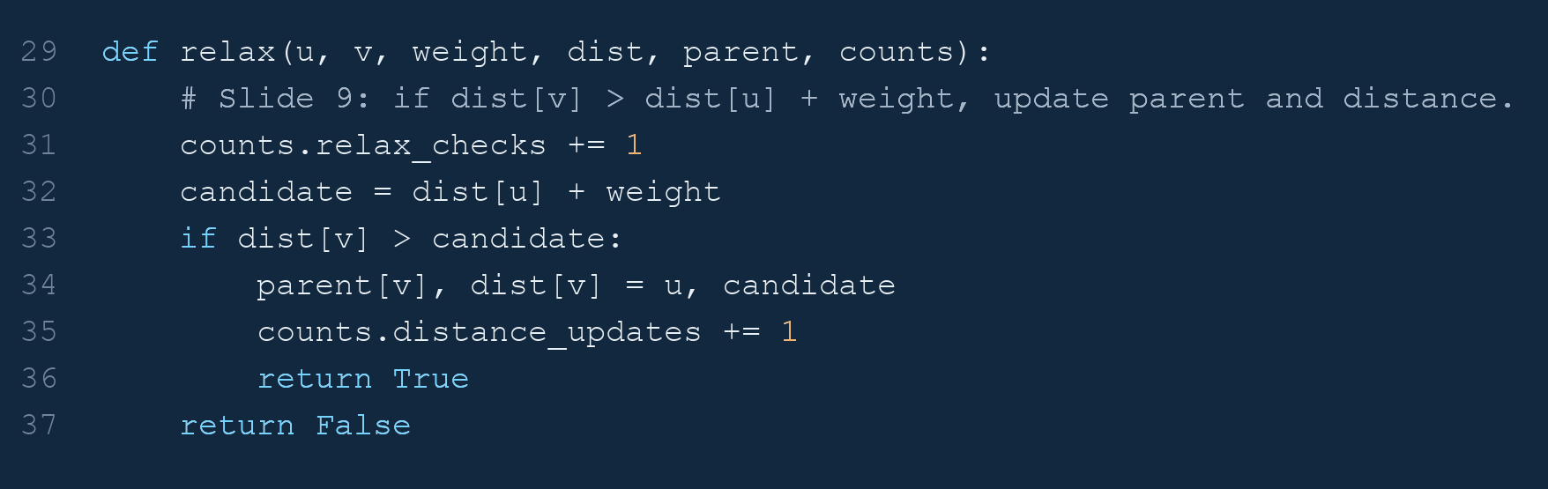
ALGORITHM
Actual code: the shared relaxation function
Project_2_Dijkstra.ipynb • cell 6, lines 29–37
A successful relaxation updates both the distance and its parent.
SC2001 | Project 2: Dijkstra’s algorithm
06
Notes:
Image rendered directly from the actual notebook source. Project_2_Dijkstra.ipynb • cell 6, lines 29–37. Original indentation, comments and counter increments are preserved. A successful relaxation updates both the distance and its parent.
Exact excerpt:
def relax(u, v, weight, dist, parent, counts):
# Slide 9: if dist[v] > dist[u] + weight, update parent and distance.
counts.relax_checks += 1
candidate = dist[u] + weight
if dist[v] > candidate:
parent[v], dist[v] = u, candidate
counts.distance_updates += 1
return True
return False

Slide 7
EXPERIMENTAL METHOD
Measure the work that explains the complexity
COUNT
COUNT
INTERPRET
Neighbor discovery
Queue + relaxation
Work, not seconds
Matrix-cell probes in A.
Adjacency entries in B.
Minimum comparisons, heap comparisons/swaps, relaxation checks and updates.
Fixed seeds give reproducible counts. Constants still affect actual runtime.
V² versus E
Count queue work
No runtime claim
Counting only relaxations would hide the difference: both attempt E relaxations.
SC2001 | Project 2: Dijkstra’s algorithm
07
Notes:
A core-operation score counts constant-time algorithmic events. We include work inside the queues, not just relaxation calls. The score groups some constant-size actions, such as a distance/parent update, into one event. Different events have different real costs. Do not call the ratios runtime speedups. Graph generation, conversion and validation are excluded.

Slide 8
INPUT GENERATION AND VALIDATION
Vary vertices and edges separately
01 • V SWEEP
02 • E SWEEP
03 • VALIDATE
Grow the graph
Increase density
Independent oracle
V: 24, 48, 96, 192, 384
Sparse: E = 4V
Dense: E = ⌊V(V − 1)/2⌋
Fix V = 192.
Increase E from 191 to 36,672.
Keep source = 0.
Compare against Bellman–Ford. Check reconstructed paths and invalid inputs.
3 seeds per setting
Identical inputs
57 experiment graphs
All presentation plots use linear axes and one graph per slide.
SC2001 | Project 2: Dijkstra’s algorithm
08
Notes:
Three seeds: 11, 29 and 47. Directed simple graphs, no self-loops, weights 1 to 100. A shuffled chain from source zero guarantees reachability. Other edges are sampled without replacement. This is a controlled family, not a uniform sample of all graphs. The V sweeps contain 30 graphs; fixed-V E sweep adds 27. Error bars are one standard deviation across seeds. Separate tests cover zero weights and unreachable vertices.

Slide 9
PART A • IMPLEMENTATION
Part A: scan the queue, then scan a matrix row
STEP 01
STEP 02
STEP 03
Extract minimum
Discover neighbors
Update distance
Scan the remaining array entries; choose the smallest dist.
Read matrix[u][v] for every v. Relax only present edges.
Write dist[v] and parent[v]. Queue reads the updated distance directly.
O(|Q|) per extraction
V probes per vertex
O(1) per update
Matrix = edge discovery. Array queue = choice of the next vertex.
SC2001 | Project 2: Dijkstra’s algorithm
09
Notes:
The array queue is unsorted. Find the minimum by comparing each remaining candidate. Remove by replacing it with the last queue entry and popping the last item, which avoids a linear shift. Priorities live in dist, so updates cost constant time. Next scan all V columns of row u, even if most entries are absent.

Slide 10
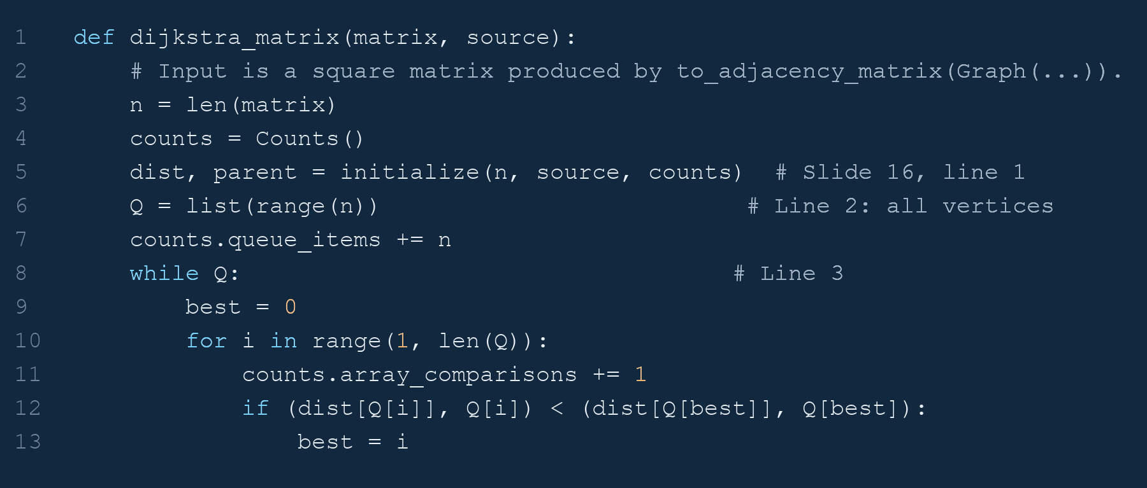
PART A • CODE 1 / 2
Actual code: Part A selects the next vertex
Project_2_Dijkstra.ipynb • cell 10, lines 1–13
The unsorted queue scans its remaining vertices to find the minimum.
SC2001 | Project 2: Dijkstra’s algorithm
10
Notes:
Image rendered directly from the actual notebook source. Project_2_Dijkstra.ipynb • cell 10, lines 1–13. Original indentation, comments and counter increments are preserved. The unsorted queue scans its remaining vertices to find the minimum.
Exact excerpt:
def dijkstra_matrix(matrix, source):
# Input is a square matrix produced by to_adjacency_matrix(Graph(...)).
n = len(matrix)
counts = Counts()
dist, parent = initialize(n, source, counts) # Slide 16, line 1
Q = list(range(n)) # Line 2: all vertices
counts.queue_items += n
while Q: # Line 3
best = 0
for i in range(1, len(Q)):
counts.array_comparisons += 1
if (dist[Q[i]], Q[i]) < (dist[Q[best]], Q[best]):
best = i

Slide 11
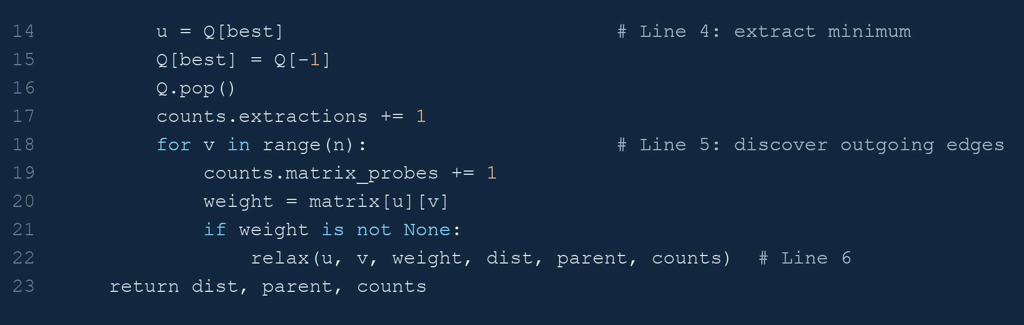
PART A • CODE 2 / 2
Actual code: Part A scans the matrix row
Project_2_Dijkstra.ipynb • cell 10, lines 14–23
Every extracted vertex scans all n columns, including absent edges.
SC2001 | Project 2: Dijkstra’s algorithm
11
Notes:
Image rendered directly from the actual notebook source. Project_2_Dijkstra.ipynb • cell 10, lines 14–23. Original indentation, comments and counter increments are preserved. Every extracted vertex scans all n columns, including absent edges.
Exact excerpt:
u = Q[best] # Line 4: extract minimum
Q[best] = Q[-1]
Q.pop()
counts.extractions += 1
for v in range(n): # Line 5: discover outgoing edges
counts.matrix_probes += 1
weight = matrix[u][v]
if weight is not None:
relax(u, v, weight, dist, parent, counts) # Line 6
return dist, parent, counts

Slide 12
PART A • THEORETICAL ANALYSIS
Part A: two sources of quadratic work
STEP 01
STEP 02
CONCLUSION
Queue selection
Matrix traversal
Total complexity
(V − 1) + (V − 2) + … + 0 comparisons.
V rows, each with V cells.
Plus E relaxation checks and R successful updates.
E ≤ V(V − 1), and R ≤ E.
Matrix storage: Θ(V²).
Auxiliary storage: Θ(V).
V(V − 1)/2
V² + E + R
Θ(V² + E) = Θ(V²)
Even a sparse graph pays for all V² possible-neighbor checks.
SC2001 | Project 2: Dijkstra’s algorithm
12
Notes:
Minimum selection makes V(V−1)/2 comparisons because the remaining queue sizes are V down to 1. Matrix traversal performs V² probes. Relaxation checks cost E and successful updates R≤E. Initialization is linear. Since E≤V(V−1), the result is Θ(V²). This bound also applies to disconnected inputs because every vertex is processed.

Slide 13
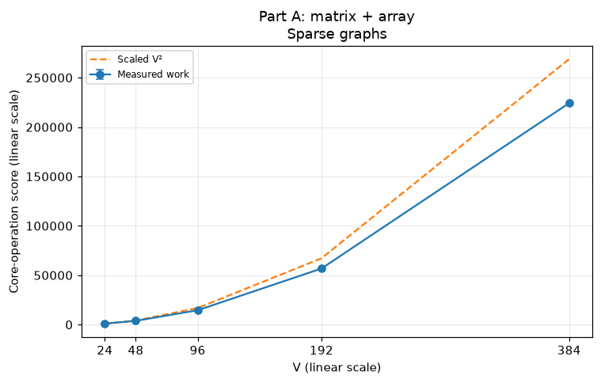
PART A • V SWEEP
Part A: sparse graphs still incur quadratic work
E = 4V
Most edges are absent.
The matrix and queue scans still grow quadratically.
Measured growth follows the V² reference.
SC2001 | Project 2: Dijkstra’s algorithm
13
Notes:
The dashed V² reference is scaled to the first measured point. Array comparisons and matrix probes match their exact formulas on every run. Error bars represent one standard deviation over three seeds. The fitted slope, computed numerically in log space but not plotted on log axes, is 1.937.

Slide 14
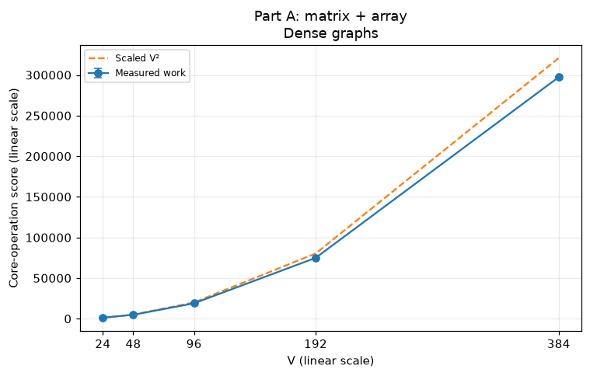
PART A • V SWEEP
Part A: dense graphs show the same growth order
E ≈ V² / 2
More edges add relaxation work.
The dominant growth remains quadratic.
Dense inputs add work without changing A’s Θ(V²) bound.
SC2001 | Project 2: Dijkstra’s algorithm
14
Notes:
Dense means E=floor(V(V−1)/2), roughly half of all possible directed edges. The measured finite-range fitted slope is 1.974. This is consistent with the exact quadratic scan counts, not an empirical proof of asymptotics.

Slide 15
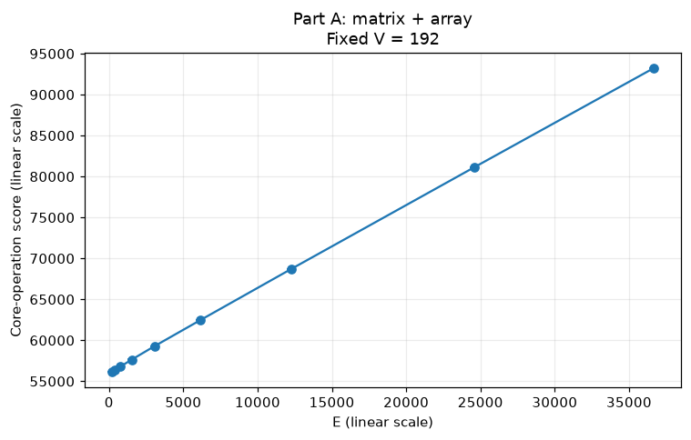
PART A • E SWEEP
Part A: at fixed V, scan costs remain constant
V = 192
36,864 matrix probes.
18,336 queue comparisons.
More edges add relaxations.
Increasing E adds work above an already large fixed baseline.
SC2001 | Project 2: Dijkstra’s algorithm
15
Notes:
The exact score is 3V + V(V−1)/2 + V² + E + R. Holding V fixed leaves only E and successful updates R variable. Do not say that A is literally unaffected by E: only its simplified asymptotic bound suppresses that dependence.

Slide 16
PART B • IMPLEMENTATION
Part B: visit existing edges and repair the heap
STEP 01
STEP 02
STEP 03
Extract minimum
Visit neighbors
Decrease key
Remove the root of an indexed binary min-heap.
Access adjacency[u] in O(1). Iterate its existing edges only.
After a successful relaxation, find v with position[v] and sift up.
O(log V)
Θ(outdegree(u))
O(log V) per update
The list avoids absent edges; the heap avoids linear minimum searches.
SC2001 | Project 2: Dijkstra’s algorithm
16
Notes:
The heap contains one entry per unprocessed vertex, not duplicate lazy entries. position[v] finds its heap index in O(1). Bottom-up heap construction is O(V). Extract-min removes the root, replaces it with the last entry and sifts down. A decreased priority is restored with sift-up. Both dist arrays are shared with their queues.

Slide 17
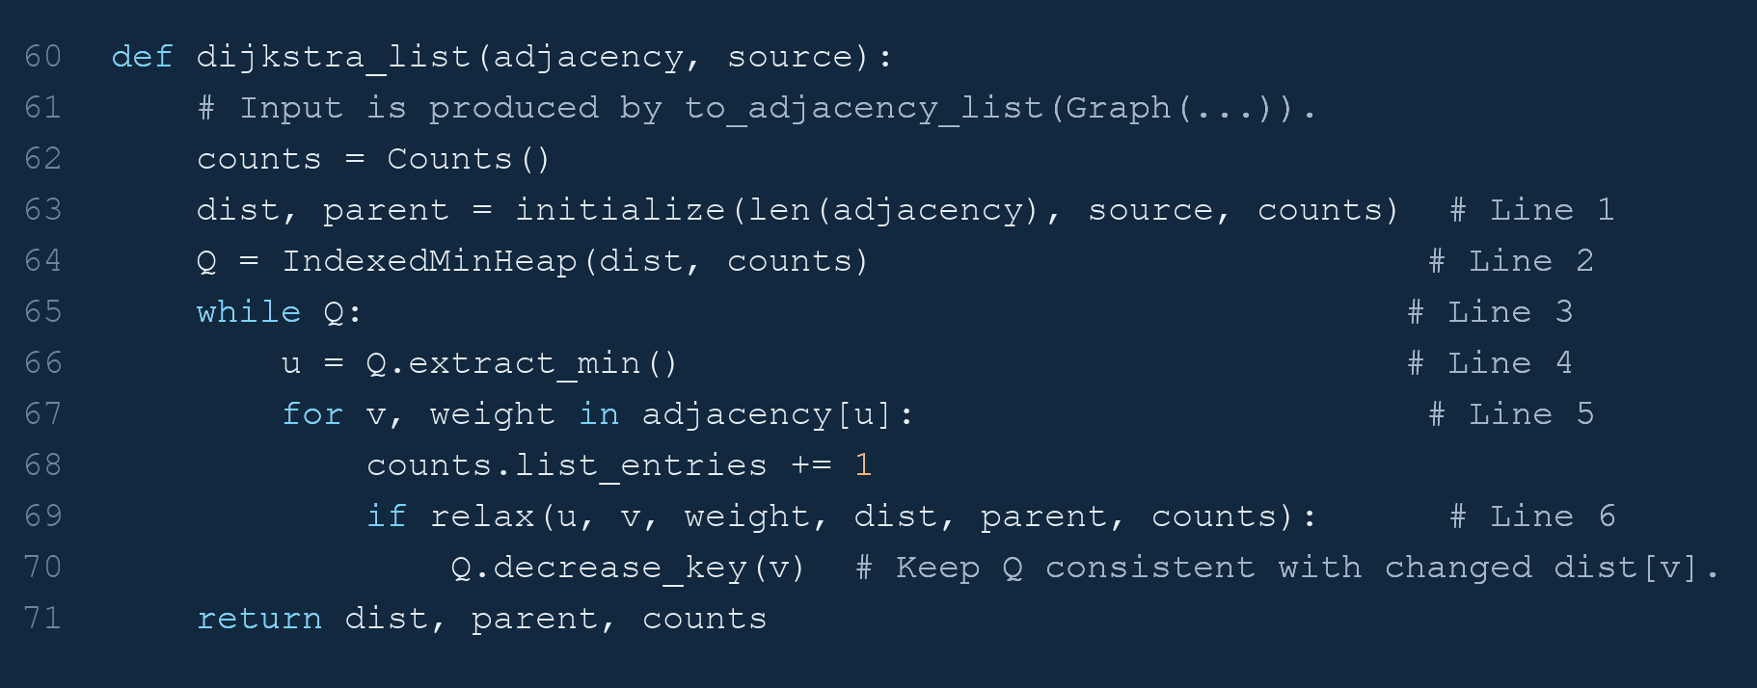
PART B • CODE 1 / 3
Actual code: Part B uses adjacency lists
Project_2_Dijkstra.ipynb • cell 15, lines 60–71
Only existing neighbors are visited; successful updates call decrease-key.
SC2001 | Project 2: Dijkstra’s algorithm
17
Notes:
Image rendered directly from the actual notebook source. Project_2_Dijkstra.ipynb • cell 15, lines 60–71. Original indentation, comments and counter increments are preserved. Only existing neighbors are visited; successful updates call decrease-key.
Exact excerpt:
def dijkstra_list(adjacency, source):
# Input is produced by to_adjacency_list(Graph(...)).
counts = Counts()
dist, parent = initialize(len(adjacency), source, counts) # Line 1
Q = IndexedMinHeap(dist, counts) # Line 2
while Q: # Line 3
u = Q.extract_min() # Line 4
for v, weight in adjacency[u]: # Line 5
counts.list_entries += 1
if relax(u, v, weight, dist, parent, counts): # Line 6
Q.decrease_key(v) # Keep Q consistent with changed dist[v].
return dist, parent, counts

Slide 18
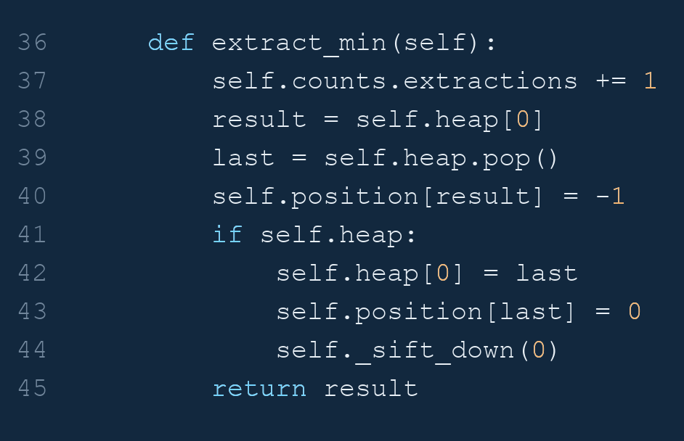
PART B • CODE 2 / 3
Actual code: extracting the heap minimum
Project_2_Dijkstra.ipynb • cell 15, lines 36–45
Replace the root with the last entry, then sift down to restore heap order.
SC2001 | Project 2: Dijkstra’s algorithm
18
Notes:
Image rendered directly from the actual notebook source. Project_2_Dijkstra.ipynb • cell 15, lines 36–45. Original indentation, comments and counter increments are preserved. Replace the root with the last entry, then sift down to restore heap order.
Exact excerpt:
def extract_min(self):
self.counts.extractions += 1
result = self.heap[0]
last = self.heap.pop()
self.position[result] = -1
if self.heap:
self.heap[0] = last
self.position[last] = 0
self._sift_down(0)
return result

Slide 19
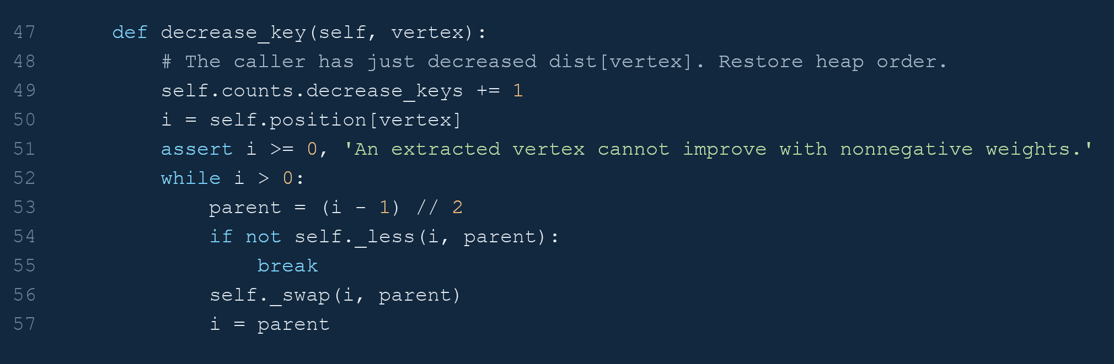
PART B • CODE 3 / 3
Actual code: decreasing a heap priority
Project_2_Dijkstra.ipynb • cell 15, lines 47–57
position[vertex] finds the heap entry in O(1); sift-up takes O(log V).
SC2001 | Project 2: Dijkstra’s algorithm
19
Notes:
Image rendered directly from the actual notebook source. Project_2_Dijkstra.ipynb • cell 15, lines 47–57. Original indentation, comments and counter increments are preserved. position[vertex] finds the heap entry in O(1); sift-up takes O(log V).
Exact excerpt:
def decrease_key(self, vertex):
# The caller has just decreased dist[vertex]. Restore heap order.
self.counts.decrease_keys += 1
i = self.position[vertex]
assert i >= 0, 'An extracted vertex cannot improve with nonnegative weights.'
while i > 0:
parent = (i - 1) // 2
if not self._less(i, parent):
break
self._swap(i, parent)
i = parent

Slide 20
PART B • THEORETICAL ANALYSIS
Part B: edge visits plus heap maintenance
STEP 01
STEP 02
CONCLUSION
Visit existing edges
Maintain the heap
Worst-case bound
Each adjacency entry is read once.
Each edge is relaxed once.
V extract-min calls.
R decrease-key calls.
Heap construction is O(V).
Use R ≤ E.
Graph space: Θ(V + E).
Auxiliary space: Θ(V).
Θ(E)
O((V + R) log V)
O((V + E) log V)
An upper bound does not say every edge causes a logarithmic-cost update.
SC2001 | Project 2: Dijkstra’s algorithm
20
Notes:
The detailed bound is O(V+E+(V+R)log V), where R≤E. This yields O((V+E)log V). For reachable graphs E≥V−1, the slides simplify it to O(E log V). With sparse graphs E=Θ(V), the bound is O(V log V). With dense graphs the worst-case upper bound is O(V² log V), but actual updates may be far fewer than E.

Slide 21
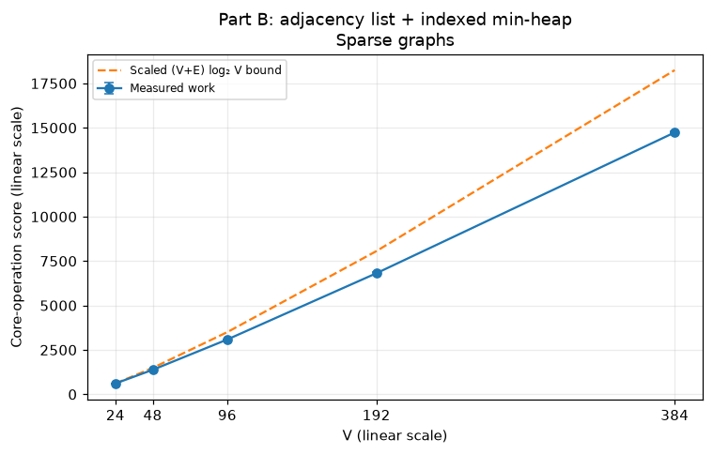
PART B • V SWEEP
Part B: sparse graphs benefit from both choices
O(V log V)
Only 4V edges are visited.
The heap replaces repeated linear minimum searches.
Sparse inputs avoid both quadratic costs found in Part A.
SC2001 | Project 2: Dijkstra’s algorithm
21
Notes:
The dashed line is the scaled upper-bound growth (V+E) log₂ V, normalized to the first measured point. It is a reference shape, not a guaranteed numerical upper bound. A power-law fit of 1.150 over this finite range is compatible with V log V growth.

Slide 22
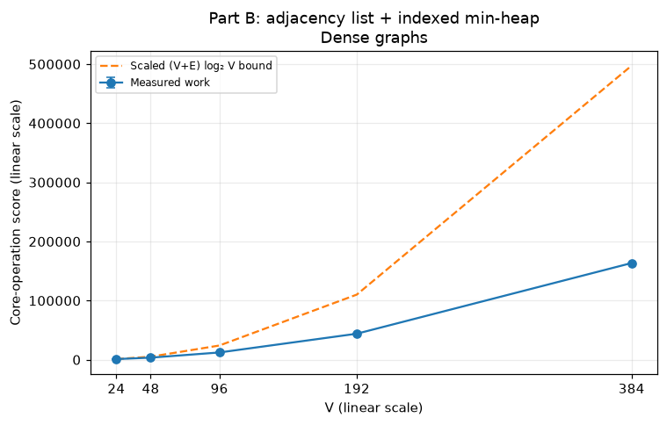
PART B • V SWEEP
Part B: a dense upper bound can be pessimistic
R can be ≪ E
Every edge is checked.
Only successful improvements trigger decrease-key.
Observed work can grow closer to V² than V² log V.
SC2001 | Project 2: Dijkstra’s algorithm
22
Notes:
Part B has a fitted finite-range slope of 1.814 here. This is not a claim of subquadratic asymptotic complexity on dense graphs: visiting E=Θ(V²) edges already gives a quadratic lower bound. The finite input range and overhead explain finite-range exponents. The reference curve is not a prediction of an exact count.

Slide 23
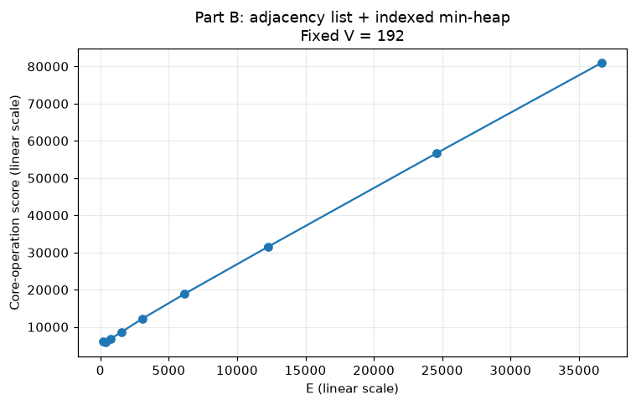
PART B • E SWEEP
Part B: adding edges directly adds list visits
V = 192
E list-entry visits.
E relaxation checks.
Heap work depends on successful updates.
At fixed V, edge traversal grows linearly with E.
SC2001 | Project 2: Dijkstra’s algorithm
23
Notes:
The exact score is 3V + 2E + 2R + heap comparisons + heap swaps. V is fixed, but R and the distance moved by keys depend on structure and weights. Increasing density does not imply every new edge successfully updates a distance.

Slide 24
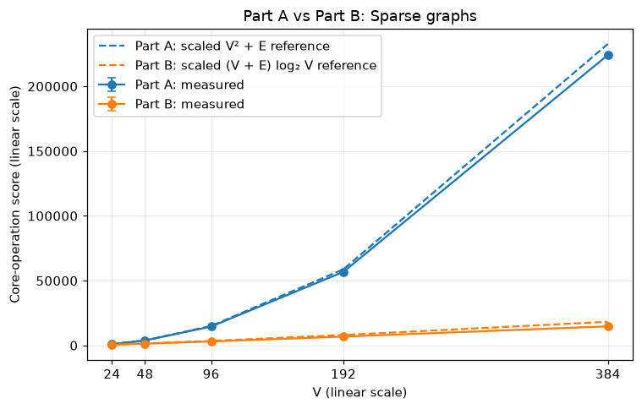
PART C • COMPARISON
Part C: Part B uses much less work on sparse inputs
A / B = 15.21
At V = 384, E = 1,536:
A: 224,192 operations
B: 14,737 operations
This is a work-score ratio, not a runtime speedup.
SC2001 | Project 2: Dijkstra’s algorithm
24
Notes:
Values are rounded means across three seeds. Blue is A and orange is B. Solid curves are measured, dashed curves are theoretical growth references: V²+E and (V+E)log₂V. Each is normalized to its own first measured point. Both graph representation and queue contribute to B’s advantage.

Slide 25
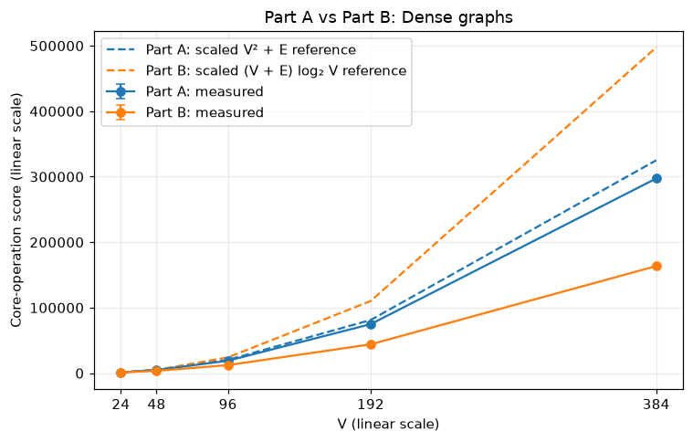
PART C • COMPARISON
Part C: Part B also wins these random dense inputs
A / B = 1.82
At V = 384, E = 73,536:
A: 297,284 operations
B: 163,496 operations
A’s better worst-case bound does not guarantee a win on every dense graph.
SC2001 | Project 2: Dijkstra’s algorithm
25
Notes:
Retain this result rather than claiming density automatically makes A faster. Dense random graphs can have far fewer successful updates than edges. The theoretical lines compare growth after independent first-point scaling; their crossing is not a universal crossover prediction.

Slide 26
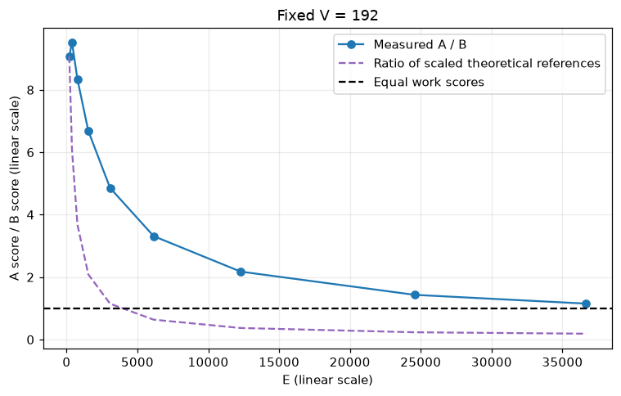
PART C • FIXED V
Part C: why the ratio falls as E increases
Read A / B
Above 1: B uses less work.
Below 1: A uses less work.
Crossing 1 is not required.
A’s fixed scan costs are large; B’s edge-dependent work catches up.
SC2001 | Project 2: Dijkstra’s algorithm
26
Notes:
At V=192, A always performs V² matrix checks and V(V−1)/2 queue comparisons. B initially visits few edges, then more as E grows. Therefore B’s advantage shrinks on these datasets. Both algorithms also perform E relaxations. The dashed curve is a ratio of independently scaled theoretical references, not a proven bound on the measured ratio. All axes are linear.

Slide 27
PART C • A CONTROLLED DENSE EXAMPLE
Frequent updates can make Part A preferable
Complete directed graph • V = 384 • E = 147,072 • R = E / 2
Part A
442,752
Part B
522,916
Counted operations; bars start at zero.
Part A uses 15.3% fewer counted operations when many priorities improve.
SC2001 | Project 2: Dijkstra’s algorithm
27
Notes:
This is a separate constructed workload, not part of the random trials. It is a complete directed graph at V=384 and E=147072. Chain edges u→u+1 have weight 1; other forward edges have weight 2V−2u+v; backward edges have weight 2V. Then dist[u]=u and every forward edge improves its target, so R=E/2=73536. Both implementations are checked against Bellman–Ford. A has about 15.3% lower score than B. The example does not prove every decrease-key costs Θ(log V).

Slide 28
PART C • WHAT ACTUALLY CAUSES THE DIFFERENCE?
Separate the representation from the priority queue
Choice
Matrix / array
List / heap
Neighbor discovery
Matrix: V² cells
List: E entries
Minimum selection
Array: Θ(V²) total
Heap: O(V log V) total
Priority updates
Array: O(1) each
Heap: O(log V) each
Specific edge lookup
Matrix: O(1)
List: O(outdegree(u))
List + array also gives Θ(V² + E): a matrix is not essential for that bound.
SC2001 | Project 2: Dijkstra’s algorithm
28
Notes:
This slide addresses a common misconception. A list can be paired with an array queue and retain Θ(V²+E) time, while visiting only existing edges. Thus the matrix itself is not the source of A’s better dense-graph worst-case guarantee. A matrix offers O(1) lookup of a particular edge; a list of lists needs a neighbor search. Dijkstra usually needs neighbor iteration instead. Representation and queue are changed together in the assignment, so the experiment cannot isolate each choice causally.

Slide 29
CONCLUSIONS
Choose based on sparsity and update behavior
01
Sparse graphs: list + heap avoids wasted scans and saves space.
02
Dense graphs: array updates give a strong worst-case bound; a win is not automatic.
03
Report what was measured: core-operation counts, not CPU speedups.
Thank you — questions?
SC2001 | Project 2: Dijkstra’s algorithm
29
Notes:
Close with three messages. First, B is the natural sparse-graph choice: both traversal and selection avoid quadratic work. Second, A has a stronger dense-graph worst-case bound, but measured results depend on updates and constants. Third, operation counts explain growth but not elapsed runtime. The assignment fixes the combinations; do not silently replace its matrix with a list. Invite questions.

Slide 30
APPENDIX • COUNTING MODEL
Exact counters connect theory to the measurements
Part A
C_A = 3V + V(V − 1)/2 + V² + E + R
Part B
C_B = 3V + 2E + 2R + H_c + H_s
R: successful relaxations H_c: heap comparisons H_s: heap swaps
Generation, conversion, plotting and validation are outside these counts.
SC2001 | Project 2: Dijkstra’s algorithm
30
Notes:
Count initializations, queue entries, extractions, array comparisons, matrix probes, list visits, relaxation checks, distance/parent updates, heap comparisons, heap swaps and decrease-key calls. Each is one declared event; these are not equally costly CPU instructions. Hc and Hs include heap construction. Assertions verify both exact score identities on every experiment.

Slide 31
APPENDIX • REPRODUCIBILITY
Validation, scope and sources
VALIDATION
LIMITATIONS
SOURCES
Independent checks
Controlled experiments
Project materials
Bellman–Ford distances.
Reconstructed path weights.
Zero weights, ties and disconnected graphs.
Three seeds per setting.
Moderate input sizes.
Counts ≠ elapsed time.
References are scaled.
Project 2.pdf: parts a–c
06_ShortestPath.pdf: slides 9–10, 13, 15–18
Project_2_Dijkstra.ipynb
All checks passed
No universal crossover
Notebook results
Speaker notes include the detailed explanations and assumptions.
SC2001 | Project 2: Dijkstra’s algorithm
31
Notes:
The notebook has six hand-crafted correctness cases, 40 random correctness graphs, 57 experimental graphs and six invalid input cases. Four additional high-update dense graphs are checked as well. References: Project 2.pdf parts a–c; 06_ShortestPath.pdf printed slides 9–10 for relaxation and initialization, 13 for Bellman–Ford, 15–18 for Dijkstra. The slide deck is based on the saved notebook outputs. The original Lab 1 deck supplies only design and author information, not results.

